Slide 1
taking notes…
simple as 1, 2, 3

Slide 2
how am I supposed to take notes on all that stuff in my social studies textbook?

Slide 3
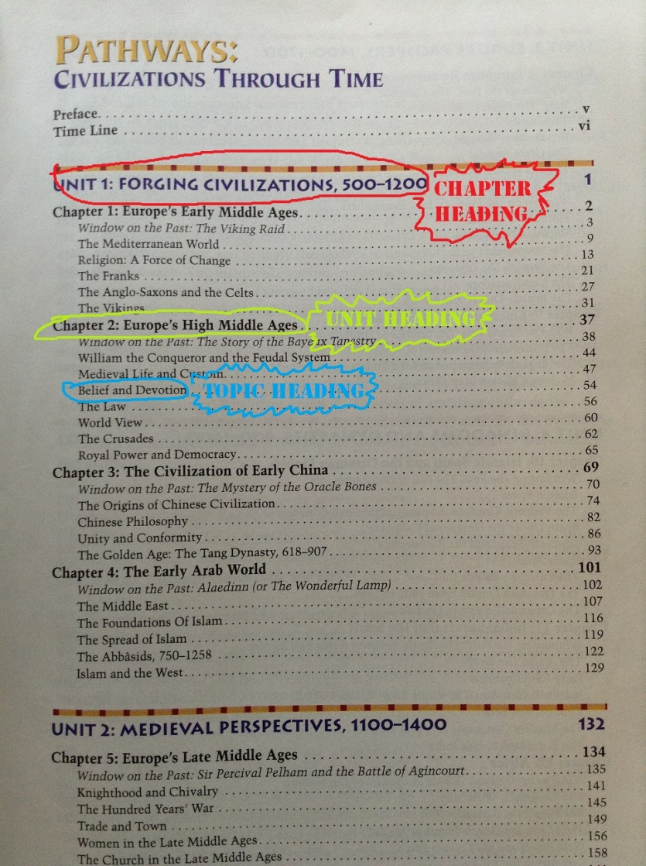
step 1: the table of contents is your friend
someone has already taken the time to tell you what to expect while you are reading, so create a word document with those chapter headings, unit headings and topic headings.

Slide 5
step 2: read it
let’s face it, if you don’t read it, it is going to be pretty tough to figure out what you need to take notes on.

Slide 6
step 3:point form notes
text: “The Vikings were mercilessly destructive. Especially in their early raids, before they began to settle in lands such as England and France, their common practice was to kill or enslave every man, woman or child they found.”
note:
Vikings = merciless in early raids, destroyed everything, killed or enslaved everyone.

Slide 7
…okay, what about videos??
use the same principles. If you are watching a video…
write down the topic
write down each subtopic as it is revealed in the video
take point form notes along the way

